Slide 1
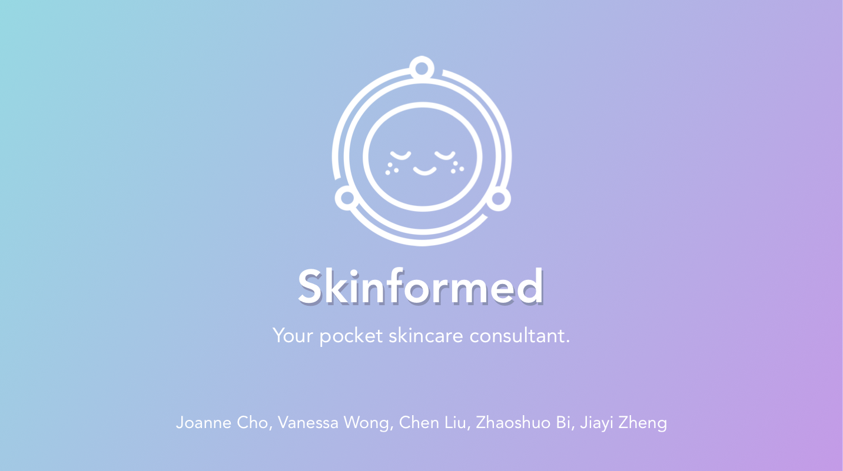
03.22.18
jec003@ucsd.edu, v7wong@ucsd.edu, chl512@ucsd.edu, jiz324@ucsd.edu
zbi@ucsd.edu
Notes:
March 22, 2018
Joanne Cho - jec003@ucsd.edu
Vanessa Wong - v7wong@ucsd.edu
Chen Liu - chl512@ucsd.edu
Zhaoshuo Bi - zbi@ucsd.edu
Jiayi Zheng - jiz324@ucsd.edu

Slide 2
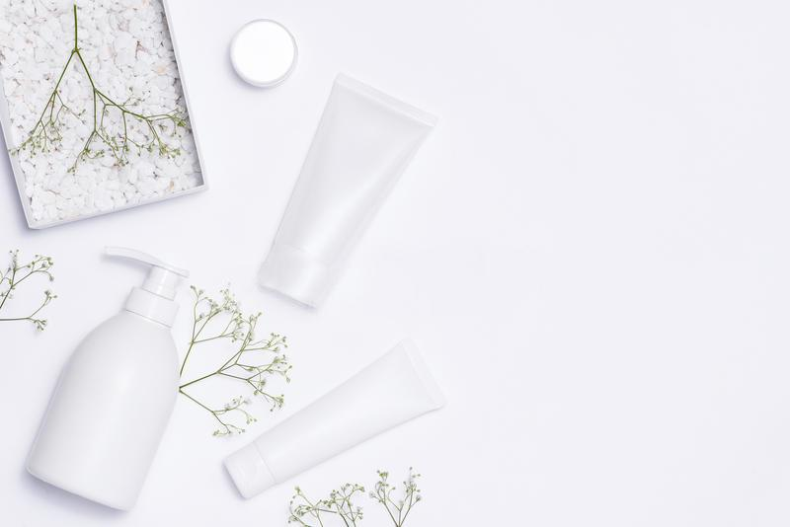

The Challenge
Skin is the body’s biggest organ in size that acts as a protective barrier between your insides and the rest of the world. We wanted to tackle this different facet of health as a way to promote self-care and wellness, which are important aspects of one’s health. Skincare is a very personal thing that can help not only with physical health, but also in mental and emotional health to relieve stress and increase overall feelings of wellness.
Notes:
The Challenge
A slide to introduce the challenge.

Slide 3
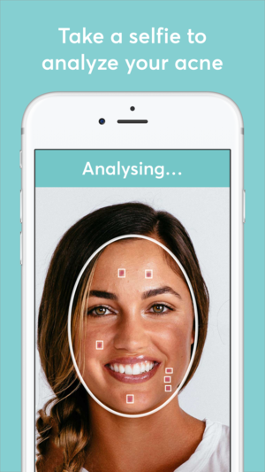
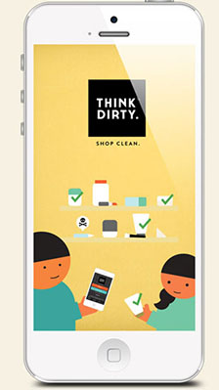
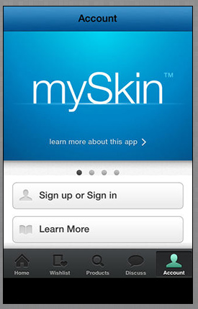
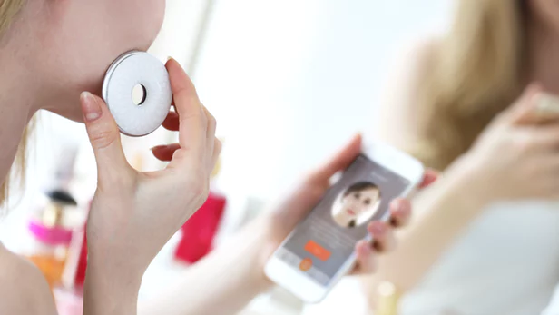
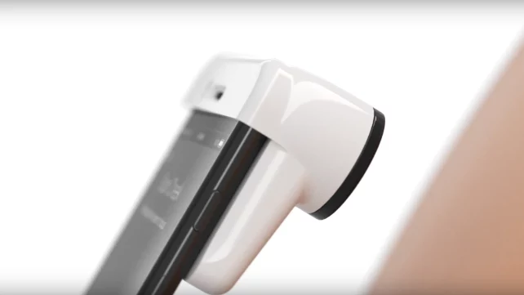
User Research: Online Research / Field Work
We conducted online research on existing skincare related applications as well as existing physical prototypes to gain a better understanding of what’s in the market so far. During this research period, we found several applications that were relevant but most catered to a single aspect of skincare- checking skin’s condition, understanding products, or getting reviews and advice. For example, some applications catered to acne only (MD Acne), others focus on revealing ingredients in products (ThinkDirty), and yet others act as advice forums to provide information on certain products as well as conditions for users (mySkin). Most physical prototypes were scanners that indicate skin condition- we chose to keep this functionality.
We chose to target beginners as we found a gap in the market for an application that catered to true skincare beginners and narrowed our application’s foci on checking skin’s condition and getting reviews and advice to make personalized routines.
Notes:
User Research:
Online research / Field Work

Slide 4
Links from Online Research
Skincare Applications and Devices
https://www.mdacne.com/
https://www.thinkdirtyapp.com/
https://www.myskin.com/
http://en.wayskin.com/
https://www.neutrogena.com/skin360-app.html
Skincare-Related Articles
https://www.cnet.com/news/neutrogena-skin360-skinscanner-for-iphone-is-like-a-microscope-for-your-face/
https://www.indiegogo.com/projects/way-your-personal-skincare-companion#/
http://www.reviewed.com/home-outdoors/features/this-neutrogena-face-scanner-judges-the-quality-of-your-skin
https://www.himirror.com/us_en/product/himirror/innovation-skin-analysis
From our competitive analysis, we found aspects within existing applications that inspire our own application as well as features that were extraneous and we opted to leave out. Our application aims to bridge the gap between multiple features such as a skin scanner, a product search, and a to-do list for routines.

Slide 5
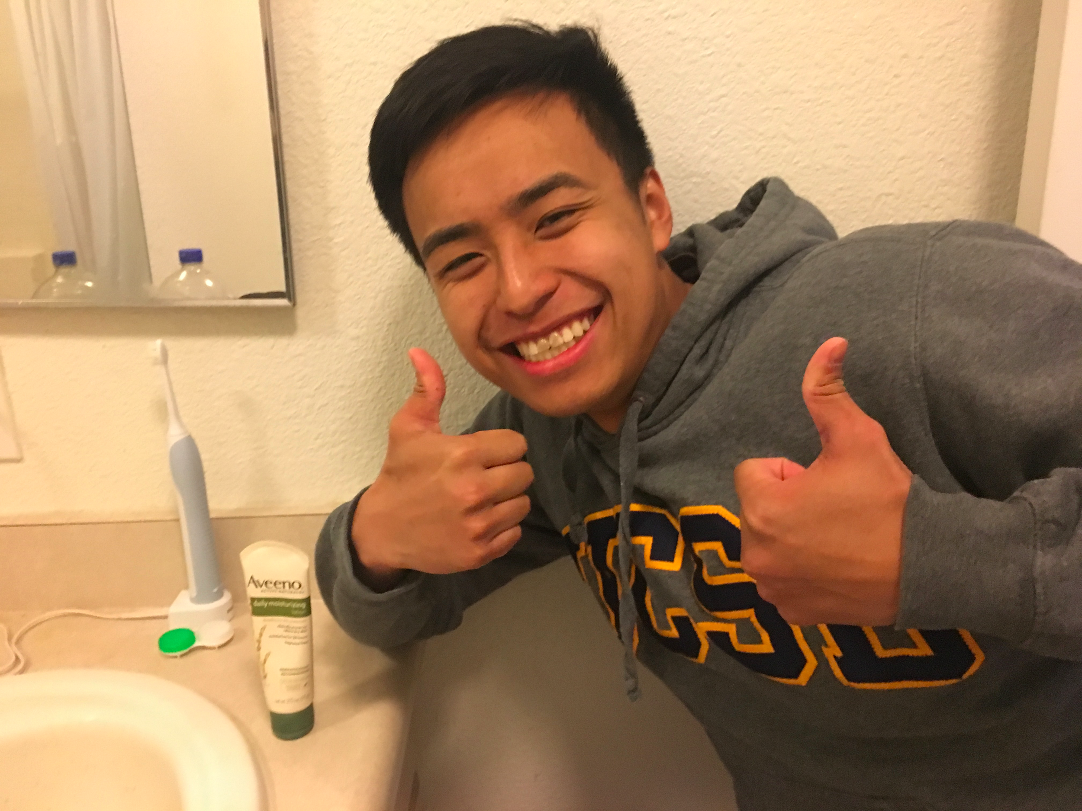
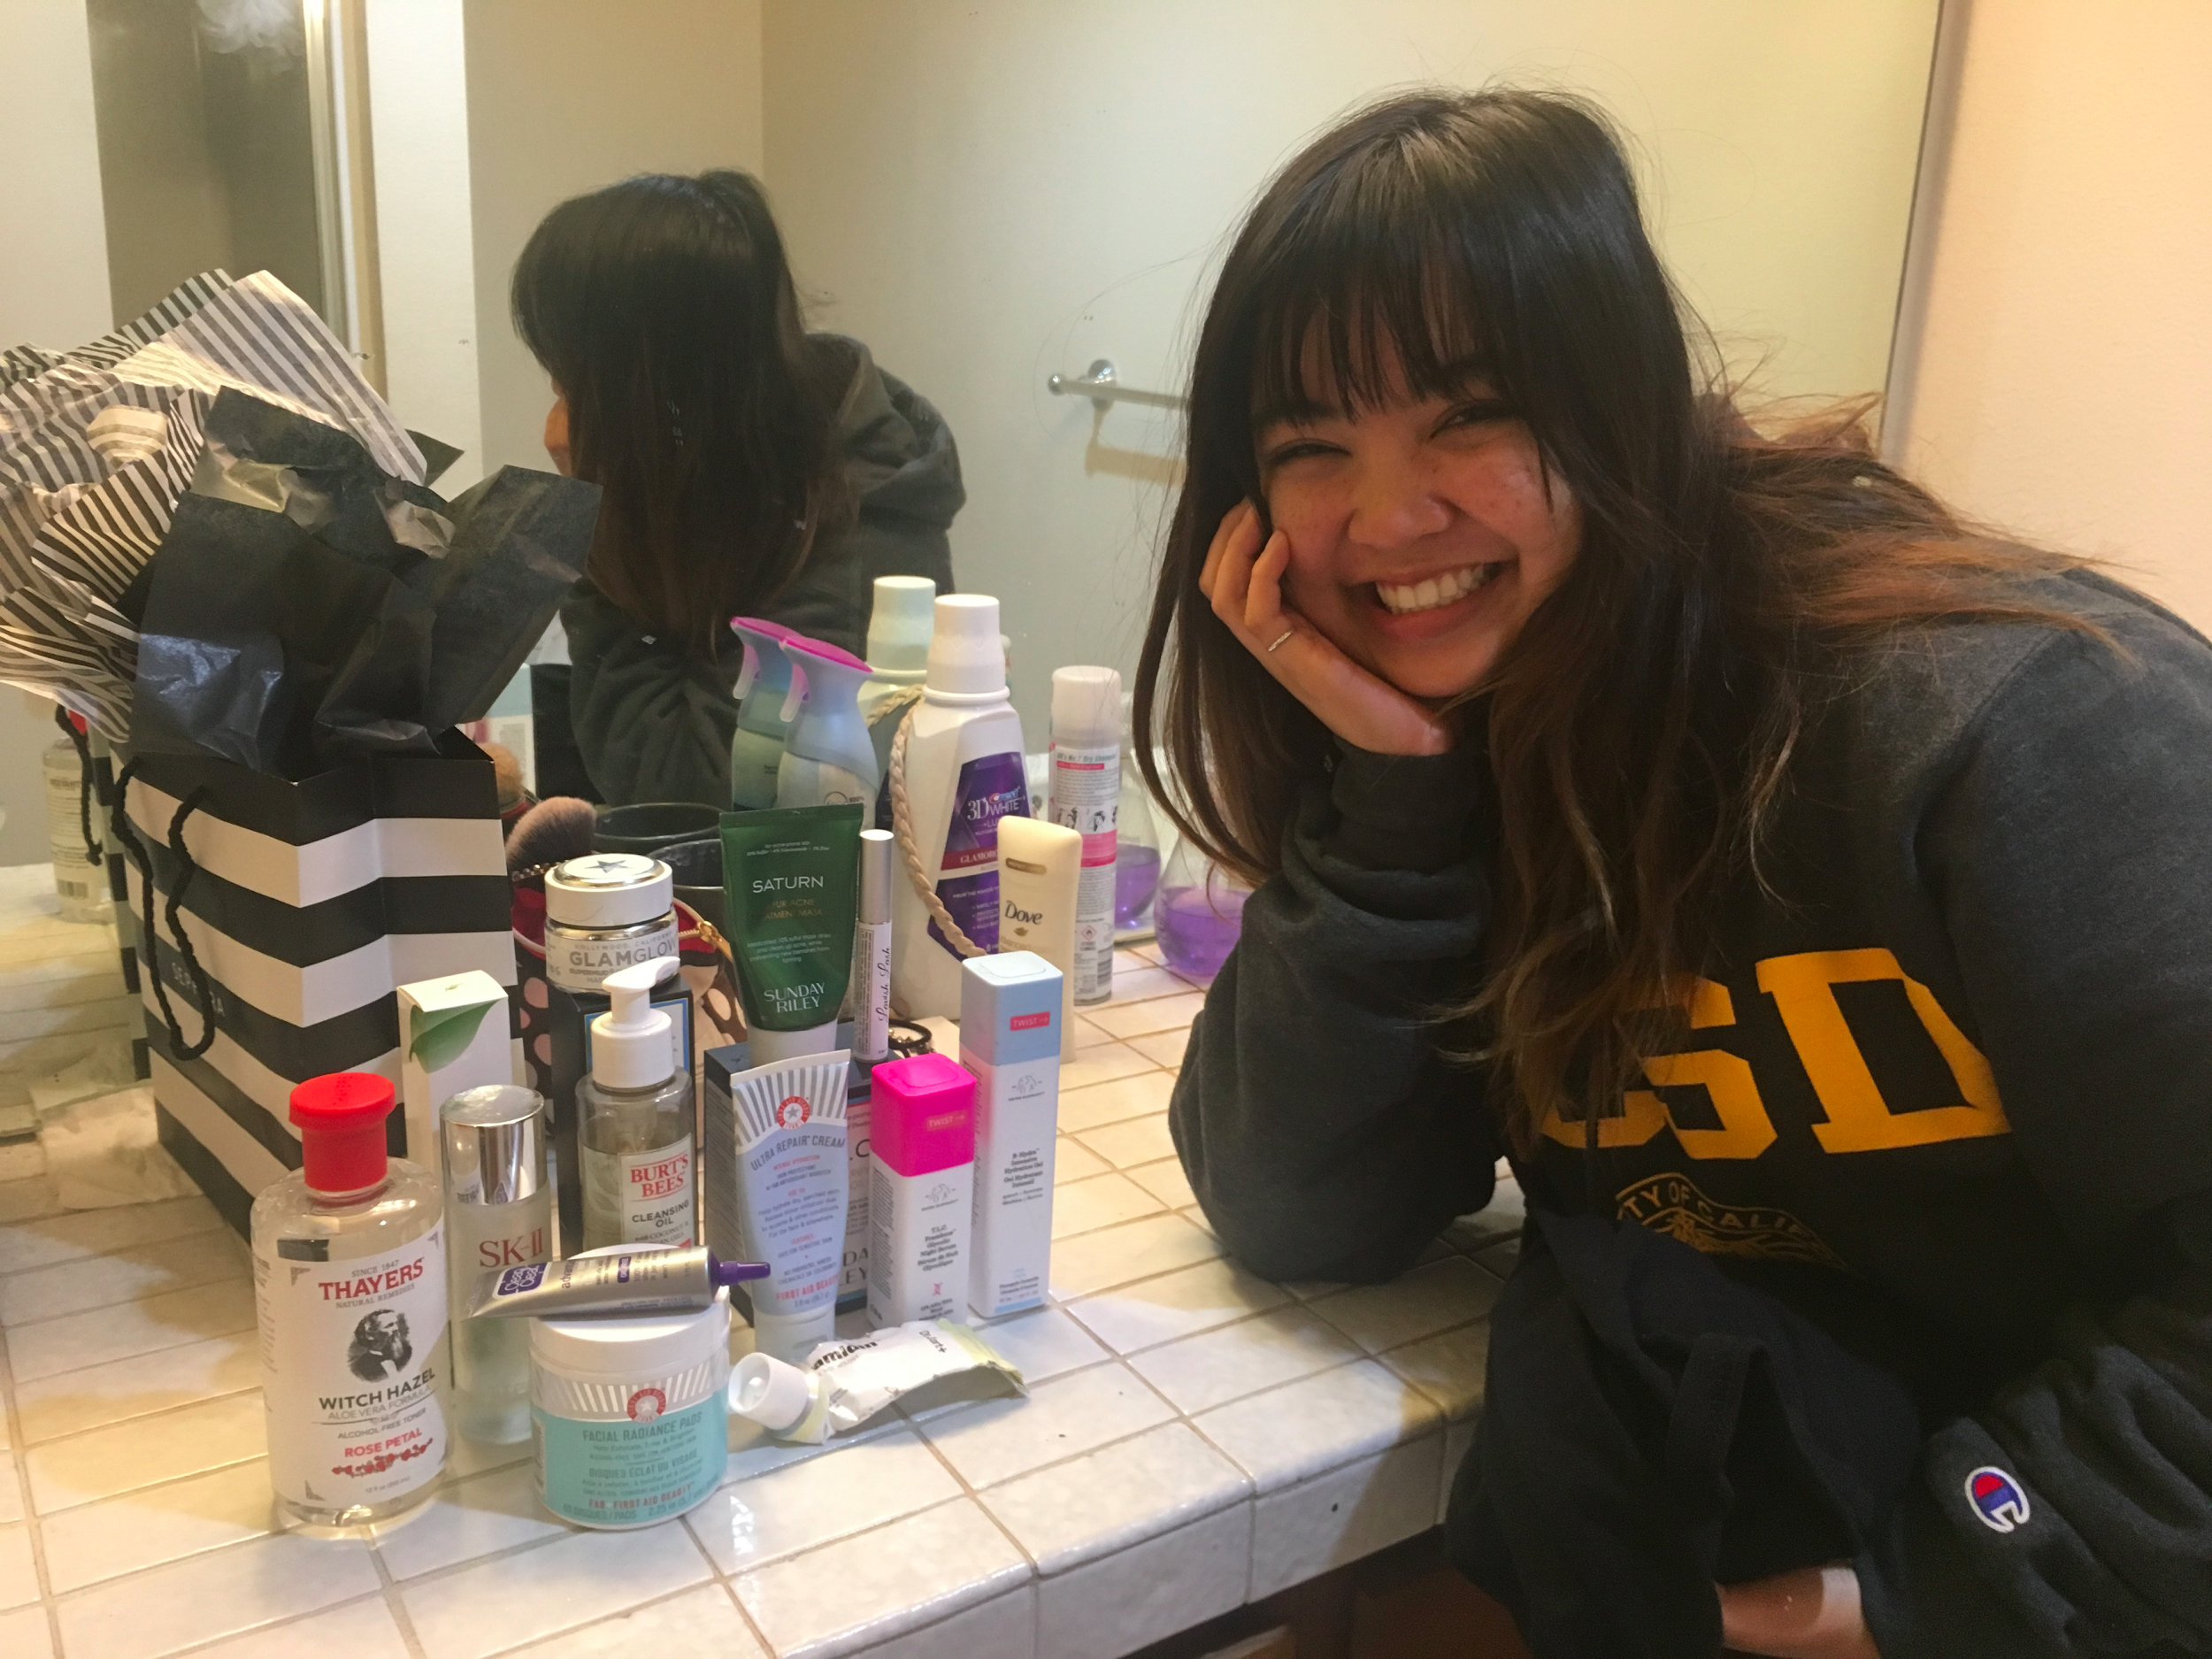
User Research: Interviews
For the interview phase, each team member conducted two interviews for a total of ten interviews. We used a set interview guide of fixed questions to maintain consistency. Through this field research, we found that skincare routines are extremely personal experiences, so while many interviewees did not want to be video-recorded, some allowed us to take photos and record audio. After the interviews were conducted, we debriefed by sharing most common comments from our interviews and found that many of the interviewees had a similar process of looking for skincare products. All interviewees noted the importance of price and effectiveness of the products which they typically learn from reviews on the retailer’s site, online blogs, or through word of mouth. The clear difference we found between skill groups were that experienced users were able to pinpoint their skin condition while most novices did not know.
From this, we conclude that price and effectiveness should be made clear in the application and a simple functionality should be implemented to help users understand their skin condition.
Notes:
User Research: Interviews
* Include photos & audio

Slide 6
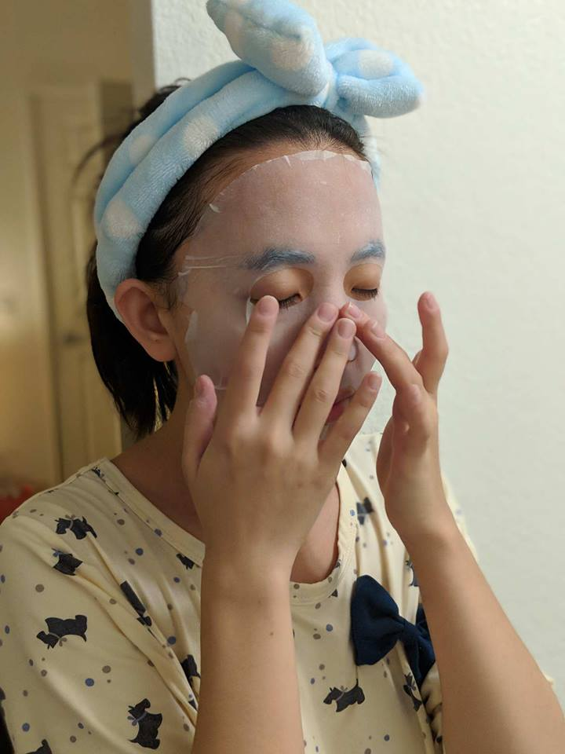
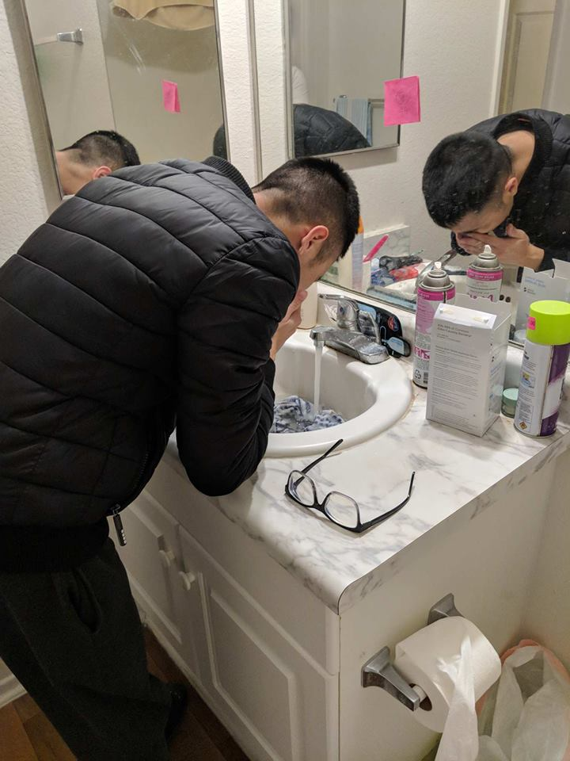
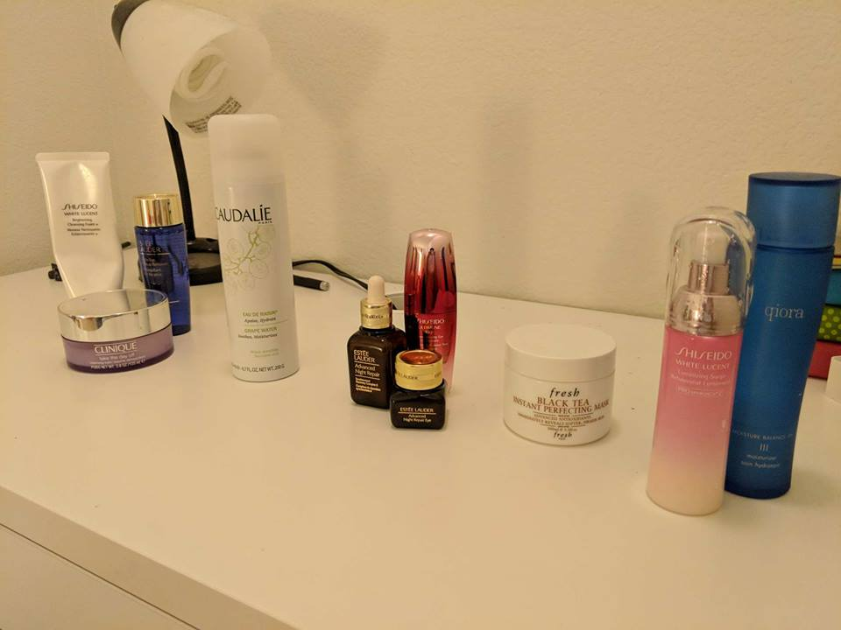
Main User Research Insights
After conducting interviews, we found several insights based on the routines of our interviewees.
1. Routines are very personalized to an individual’s unique skin condition and interest in skincare but usually occur at night time
2. The organization of user’s products correlate with a habit in consistently using their skincare products
3. Products are chosen based on the skin condition they’re meant to treat but novices (especially male novices) tend to generalize a single product for many purposes.
From these interviews and insights, we created personas that would act as our target audience- beginning skincare users who need help constructing a routine as well as a persona for our secondary users who have some knowledge of skincare products but want to expand their existing routine.
Notes:
Summary of User Research Insights:
Stakeholders, problems, user patterns

Slide 7




Personas
Frank
Novice of skincare
Doesn’t use skincare product
Only prioritizes cleanliness
Busy college student
Low budget
Mandy
Novice of skincare
Has sensitive dry skin
Uses only few products that specific cater her skin condition so that she does not get allergic
Some of the products are prescribed and she does not know what they do
Jen
Experienced user of skincare
Has some sophisticated routines for skincare
Try new products a lot
Enjoying exploring new products and new skincare techniques
Knowledgeable about skincare
Married, housewife
Notes:
Personas
Say we went to our users with our storyboards to ask if they relate

Slide 8
Personas
We created personas around our primary and secondary audiences. Each persona embodies an aspect that we hope our application can resolve.
Our college male persona Frank is a novice to skincare and he does not use any products. Frank’s time is limited and his budget is low. He does not know his skin condition at all. Mandy is also a novice to skincare because she knows little about skincare products but she does use products that are prescribed. Mandy’s time is available and her budget is less strict. Due to a third party, Mandy has some idea of her skin type. Jen is an experienced skincare user who already has created routines but wants to expand hers to include new products. Jen is used to predicting her own skin condition but does not verify it.
Notes:
Mission Statement

Slide 9
Mission Statement
To bridge the gaps between skincare recommendations, product information, and skin detection devices to allow users to easily create and follow personalized skin care routines in an accessible way.
Notes:
Mission Statement

Slide 10
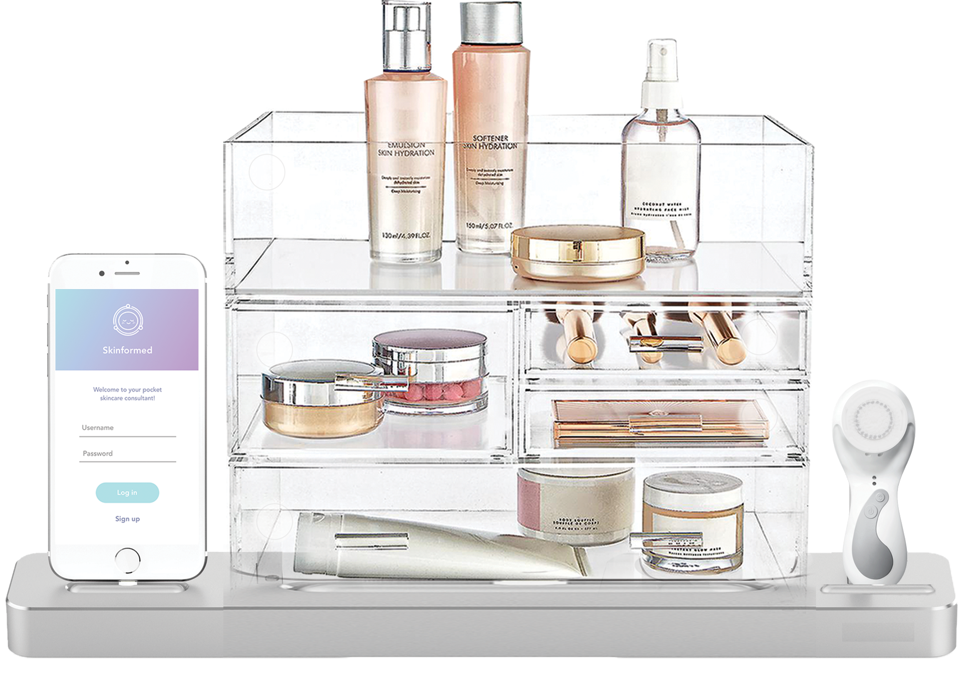
Novel Product-Service Concept
There are three parts to cater to various aspects of helping beginners create and maintain a consistent routine based on their skin conditions:
A skincare organizer including a charging dock that connects with the mobile app and scanner for user to follow his or her skincare routine step by step.
A skin sensor that scans user’s skin and connects with the mobile app to show the analysis of skin type and problems of the user.
A mobile application that connects with the skin scanner to show analysis and with the skincare organizer to track skincare routines.
Notes:
Novel Product-Service Concept:
Include details about the physical setup, communication between stakeholders, and interaction with the mobile application

Slide 11
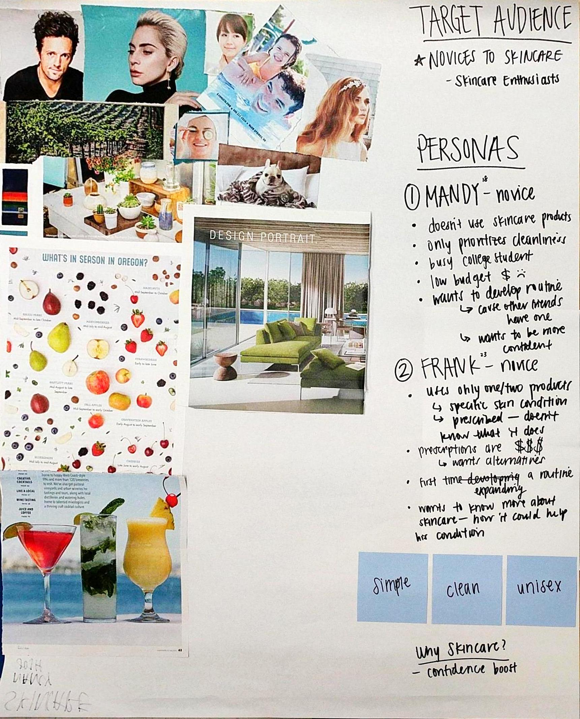
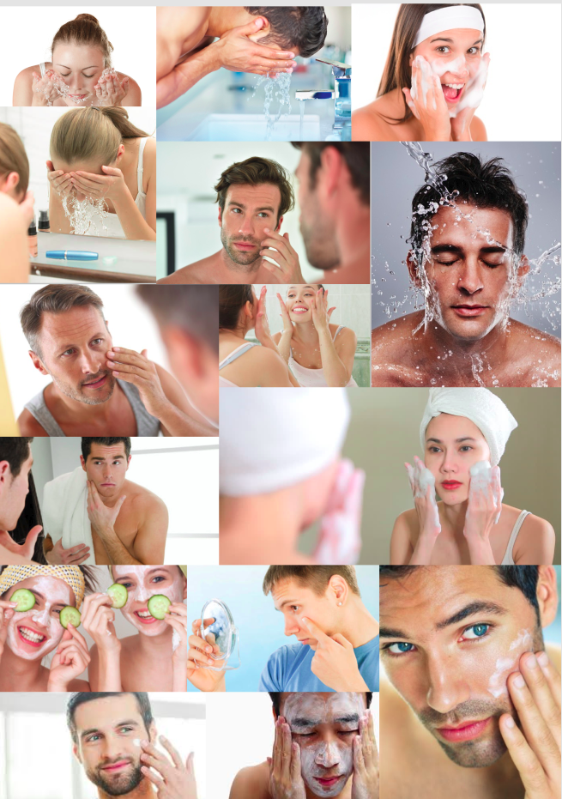
Moodboard Iterations
When creating our moodboards, we aimed to emulate the experience of the application through putting images of freshness, cleanliness, cool colors, and simplicity. We chose colors like teal, purple, and blue to adhere to keeping the application unisex.
Notes:
Make a new digital moodboard
Colors:
Teal
Purple
Blue
Application Characteristics:
Simple
Clean
Unisex

Slide 12
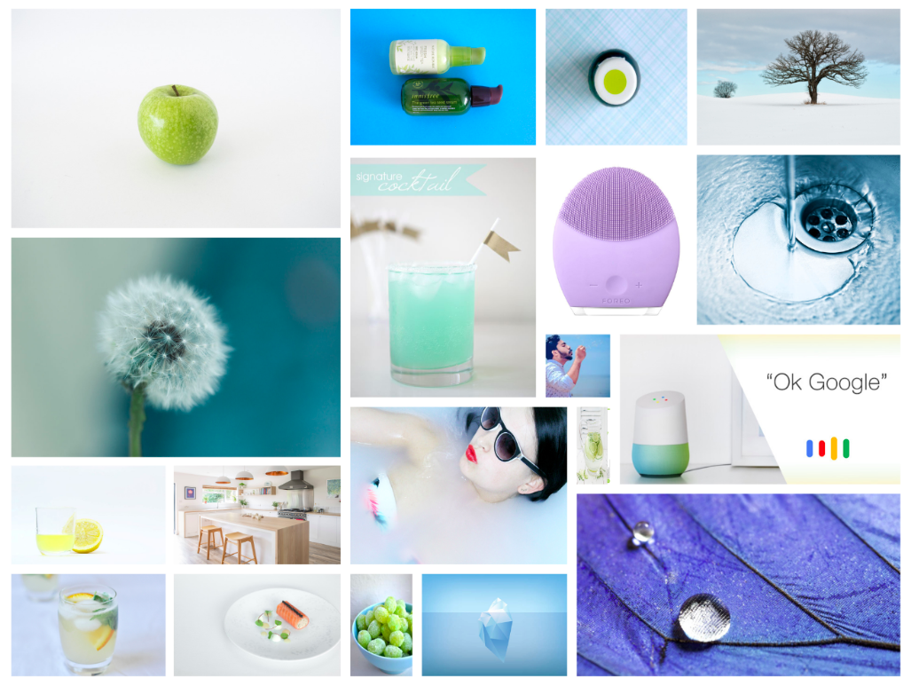
Final Moodboard
Our final moodboard captures the fresh, unisex, and simplistic vibe we wanted to express in our solution.
Notes:
Make a new digital moodboard
Colors:
Teal
Purple
Blue
Application Characteristics:
Simple
Clean
Unisex

Slide 13
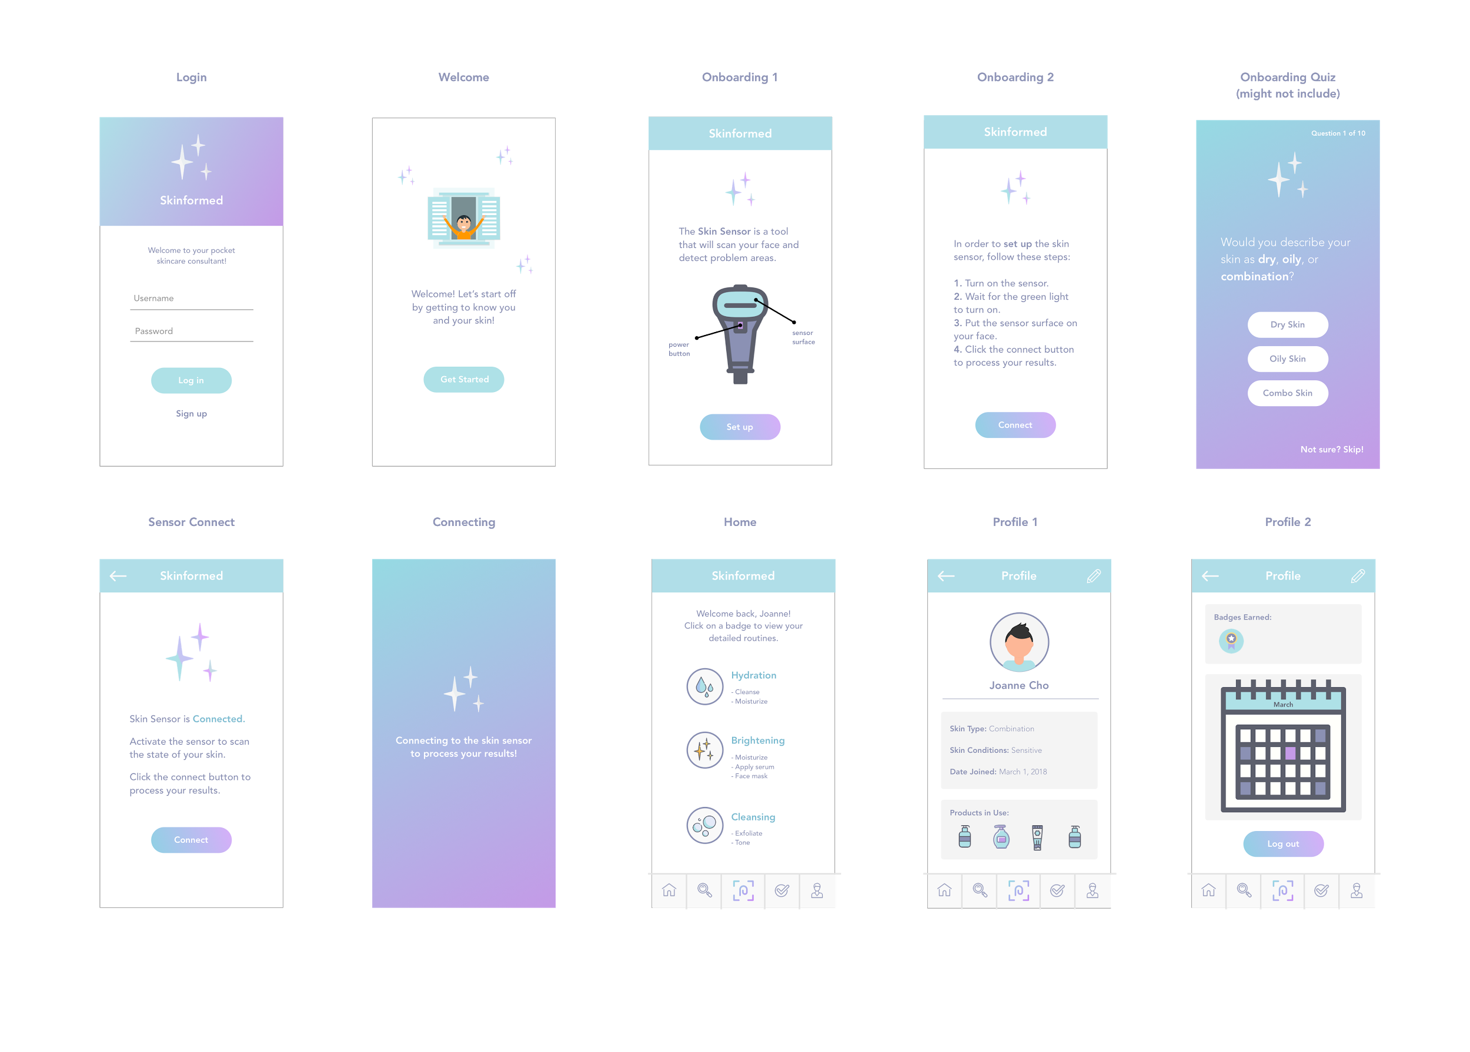
Screen Designs: Initial Iteration
These initial screen designs follow the onboarding process of introducing the user to the skin sensor and walking them through a brief skincare quiz.
Notes:
Screen Designs:
Include screen designs for at least three pages of the prototype.

Slide 14
Screen Designs: Initial Iteration
After the user has connected their skin sensor, they can scan it and view routines through their home page. The profile page consists of information about the user, their products, and their progress.
Notes:
Screen Designs:
Include screen designs for at least three pages of the prototype.

Slide 15
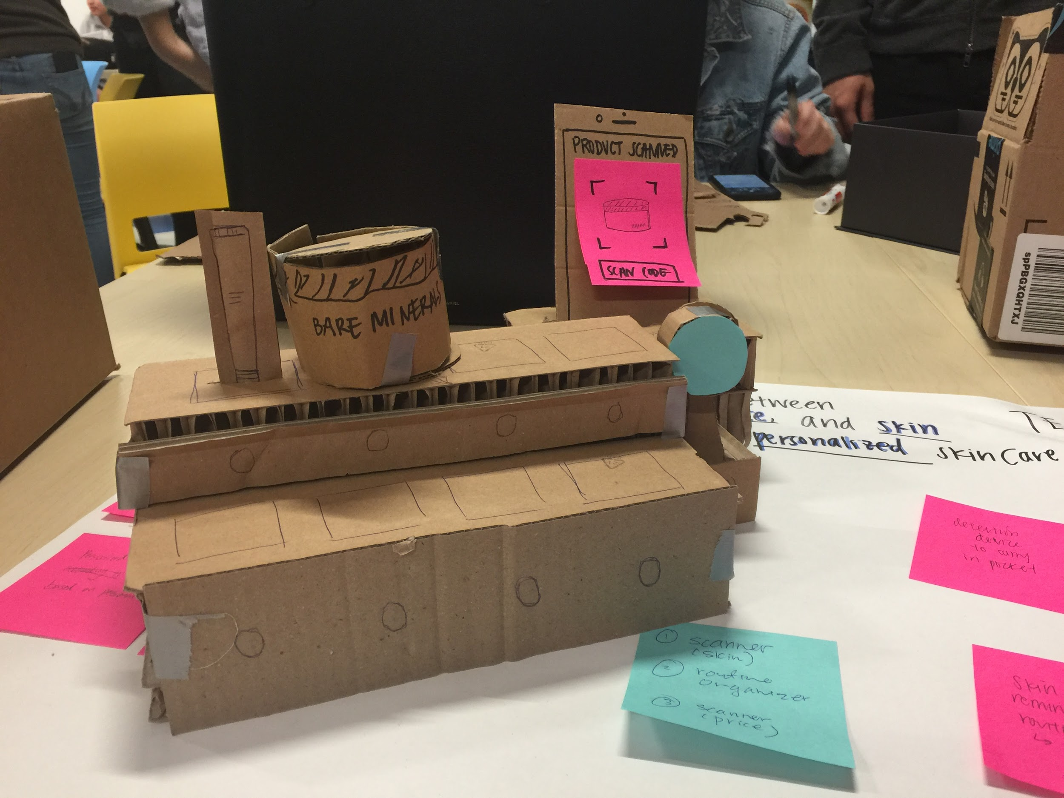
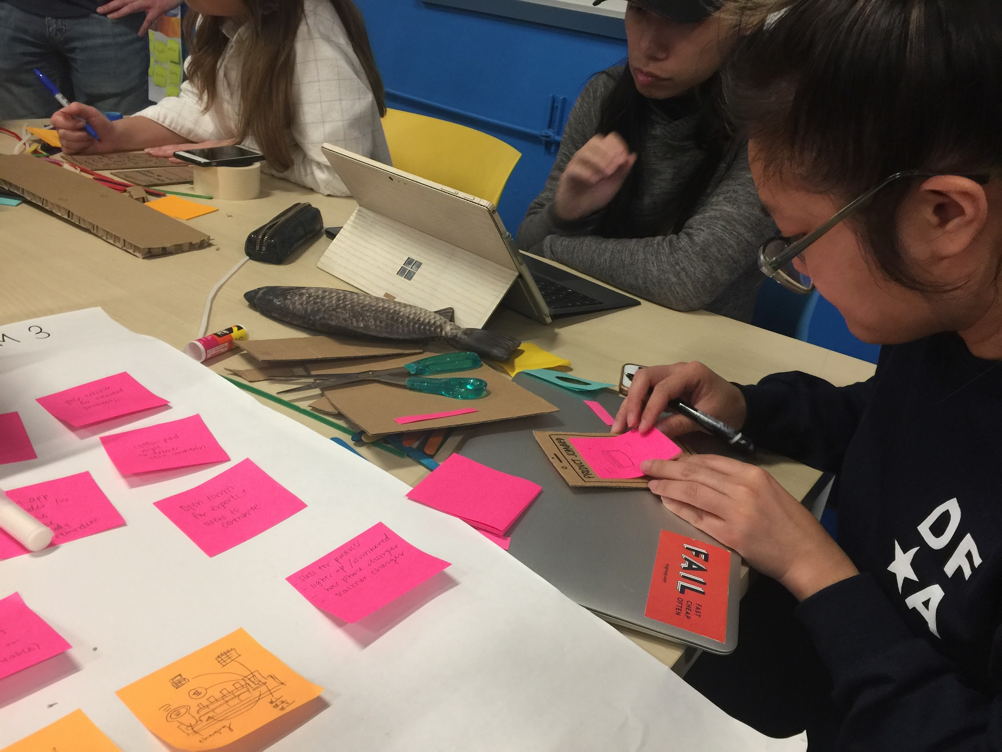
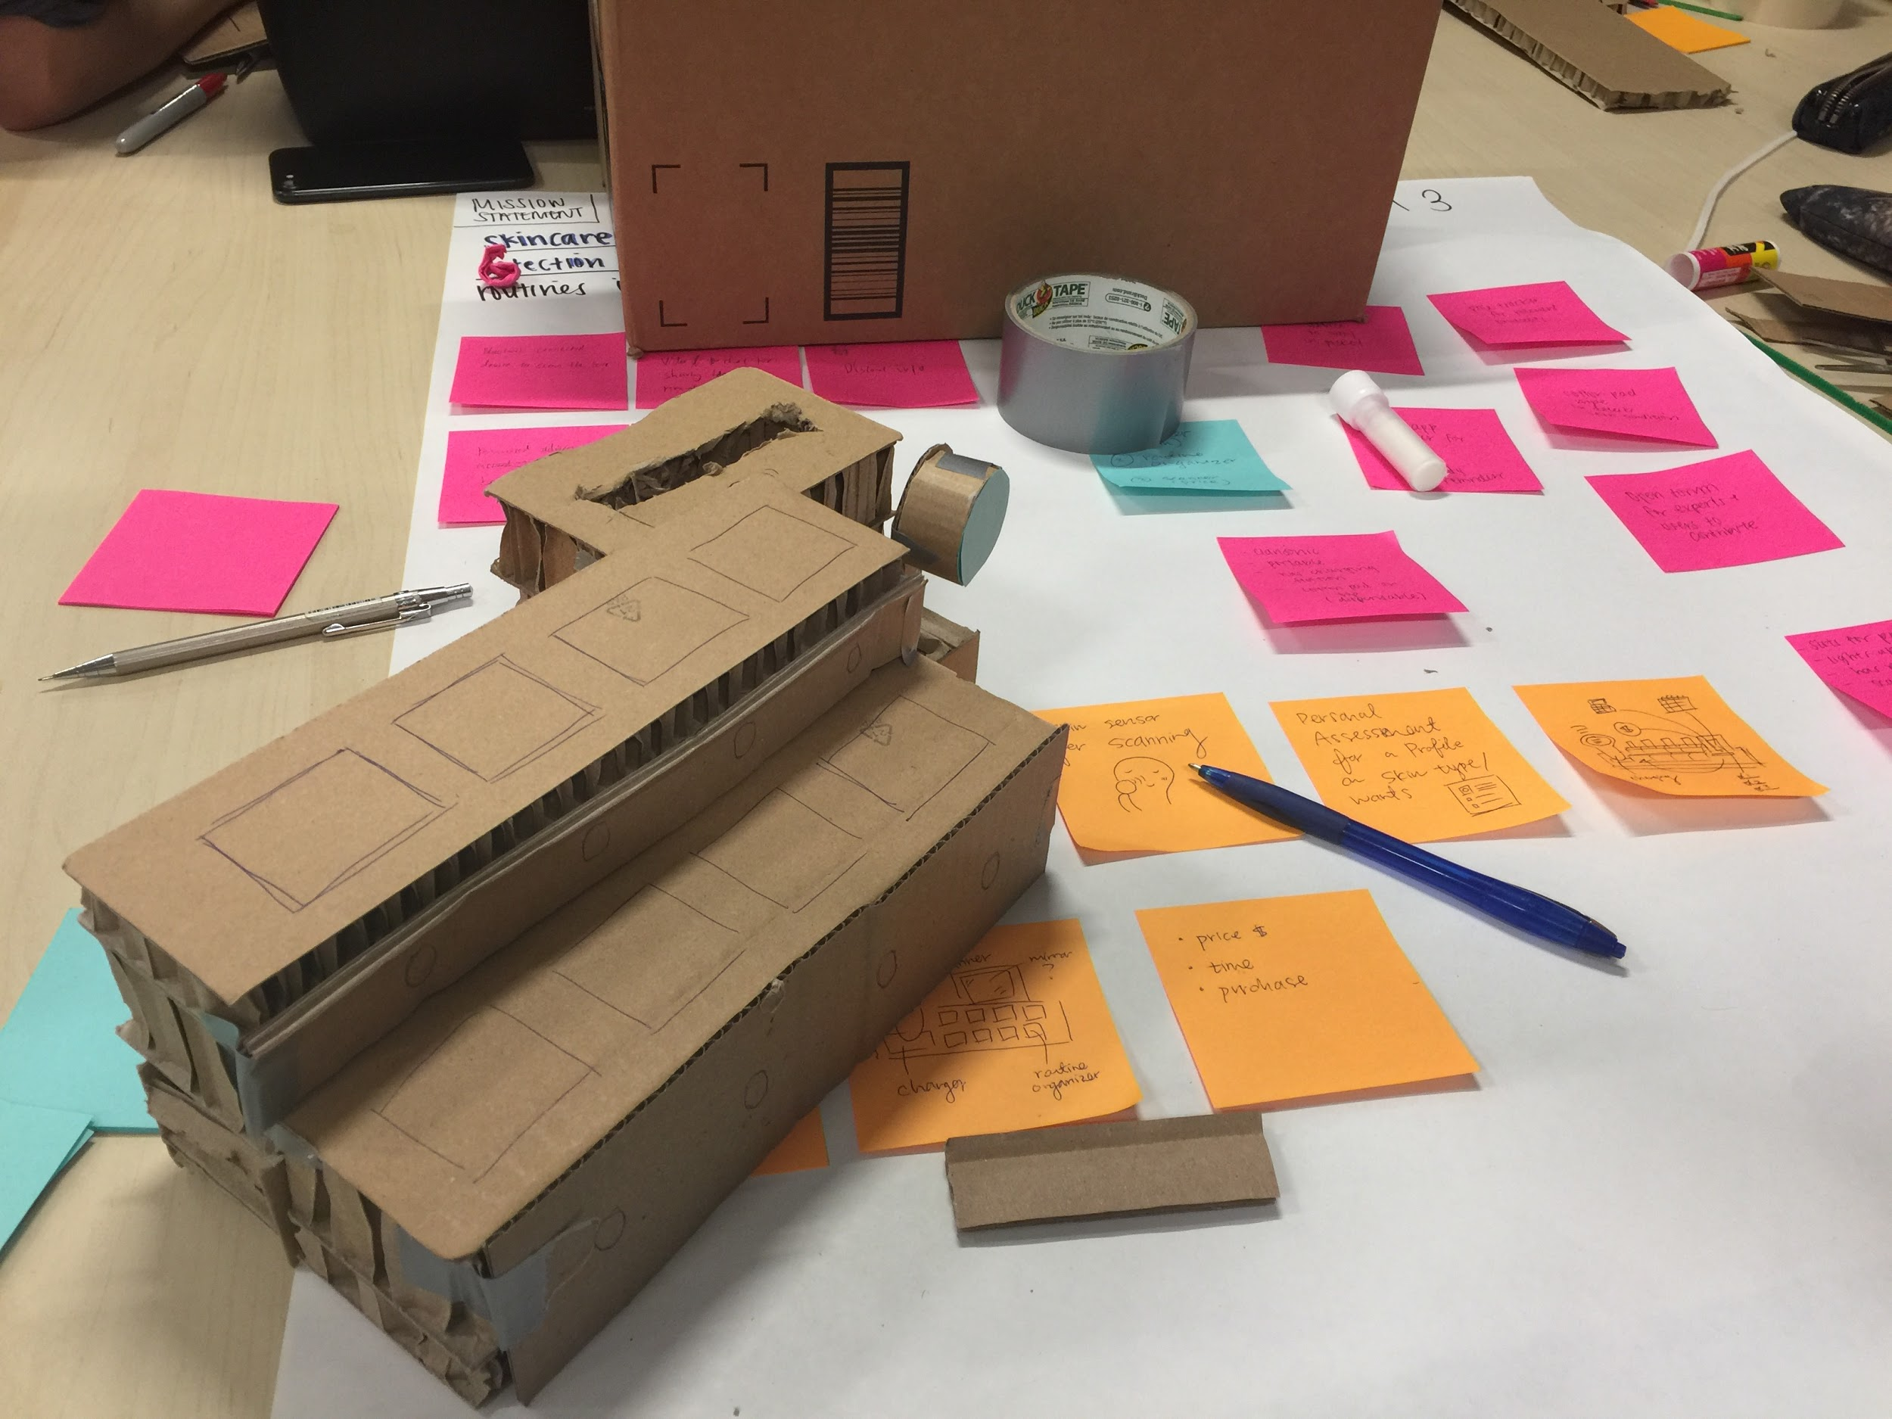
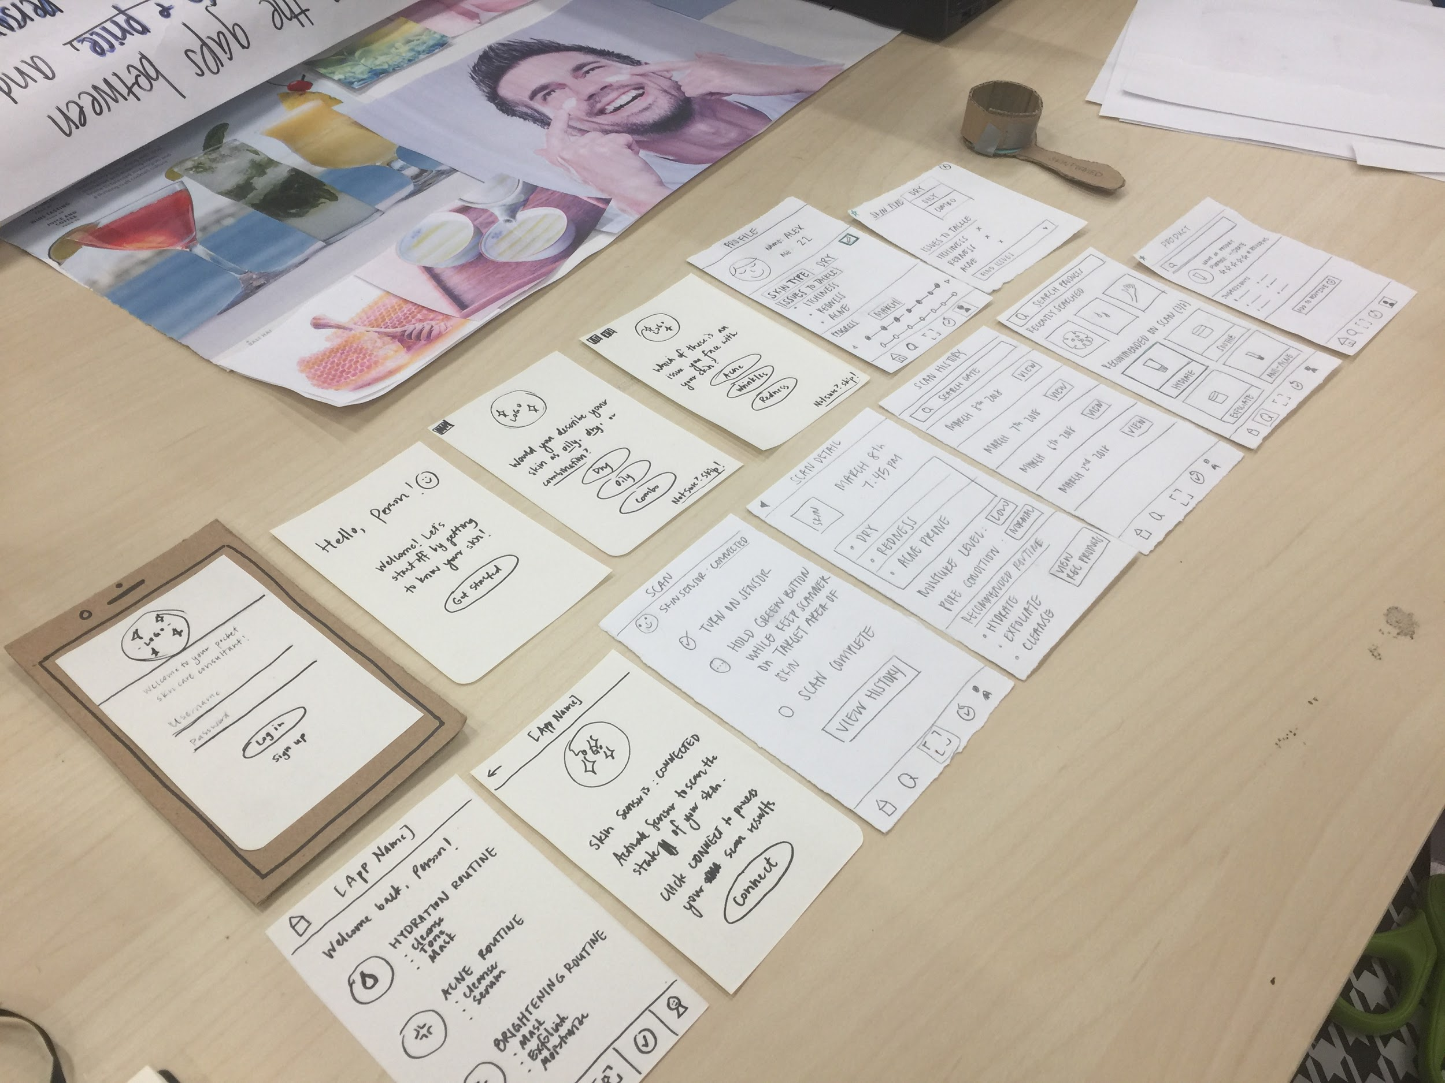
Physical Prototype: Initial Iteration
The initial prototype focus was product accessibility and convenience. So our ideas were a routine organizer that connects to the mobile app, a skin scanner, and a product price and information scanner. We later decided to combine the ideas in connecting our app and skin scanner with our routine organizer to make all features accessible in one package.
Notes:
Screen Designs:
Include screen designs for at least three pages of the prototype.

Slide 16
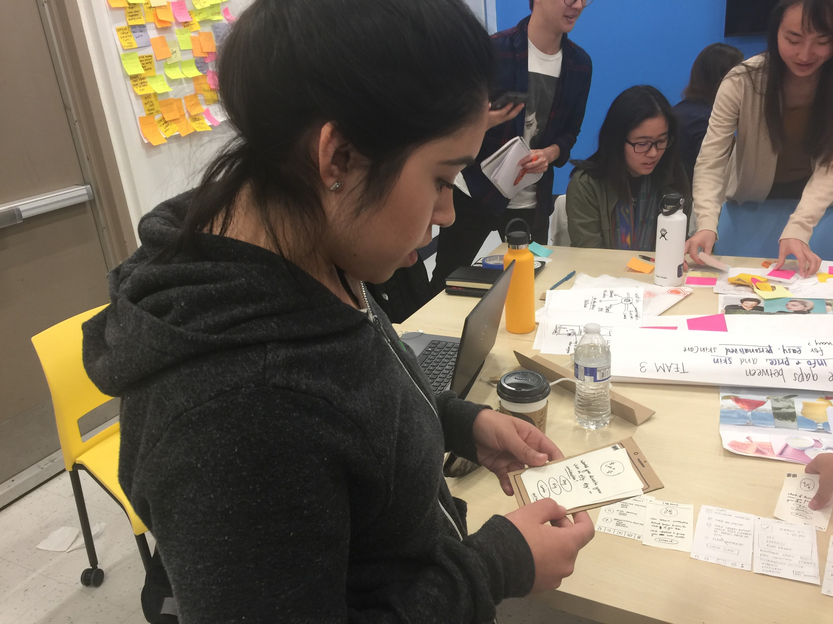
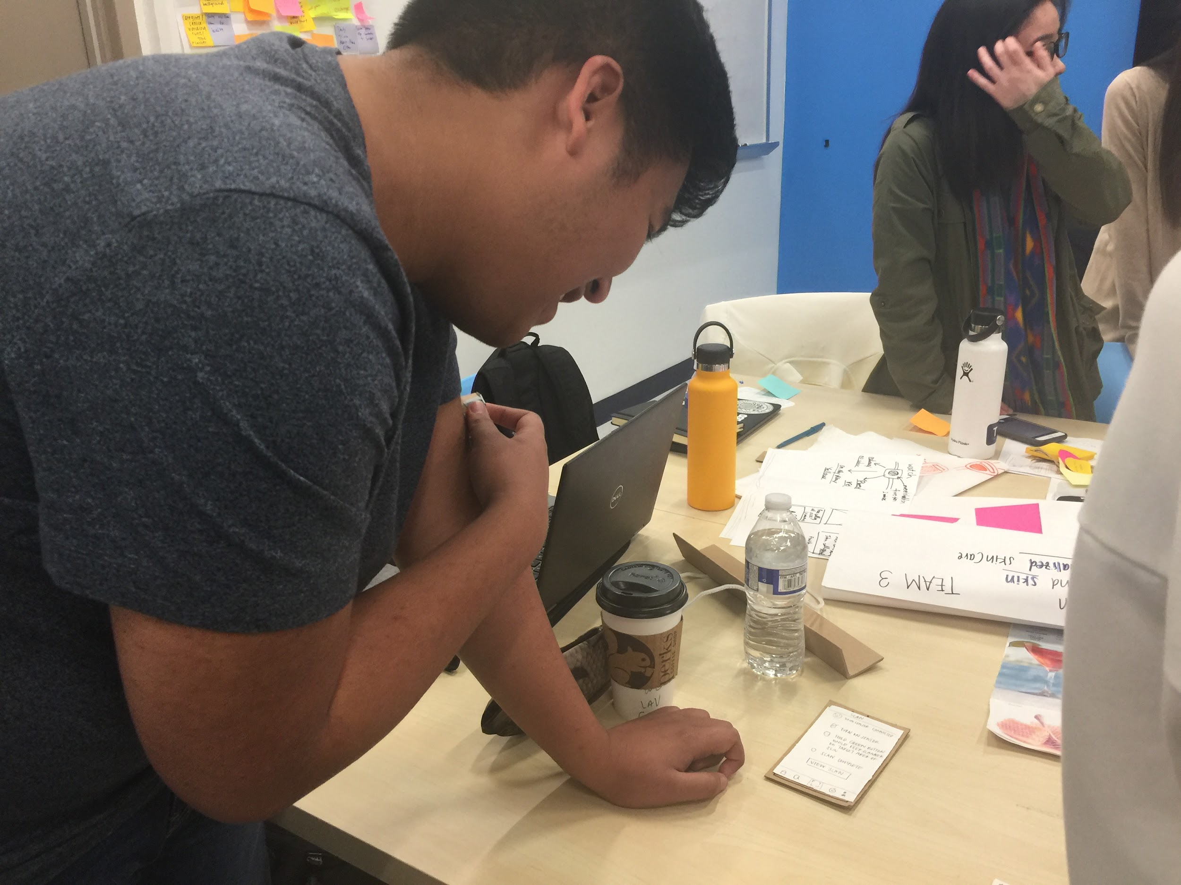
User Testing - Logistics
We performed in-person user tests on both our mobile application design as well as our physical prototype design.
We had 3 different users (novice, semi-novice, & skincare enthusiast) test both the mobile and physical prototypes. Since we have interviewed these users before, we decided to contact them again to test this prototype.
We provided the following set tasks for all users in order to maintain consistency:
Login to the application and connect your skin sensor.
Scan your face and find your results.
Find your recommended Cleansing Routine.
Find your recommended product that is good for Dry Skin.
View your skin scan detail from March 1st, 2018.
Notes:
A conclusion slide with contact information and acknowledgements.

Slide 17
User Tests - Application Prototype
Person A: Novice
Person A found the onboarding quiz confusing and thought that the application would be in charge of telling user their skin condition instead of user inputting it in the beginning. He skipped the onboarding quiz completely. He thought the static menu on the bottom was helpful for navigating to the scanner and seeing results. He liked how the recommended products go within a description for their skin type. He noted that the logo for the application may be more feminine than unisex.
Person B: Novice
Person B thought the onboarding page was “simple and easy to navigate” but didn’t think it was necessary with the scanner. She liked the modules that could pop up and show what each step in the routine meant but found the icons to be unclear as to whether they were clickable or not. She requested information on one of the icons in the menu bar and explained that it was not intuitive enough to stand by itself (she struggled to understand the Scan History button which was represented by a check mark inside a circle).
Person C: Experienced
Person C liked the onboarding quiz but was concerned that others might input wrong answers, also thought scanner should do the job. She thought the label to scan on the Scanner page was inconsistent with the action as it said “Connect” but it is actually preparing to scan. She breezed through the results and products page and noted that while she liked being able to see the progress tracked on the calendar, she believed few users would remember to input their status every single day. She also mentioned the importance of using more intuitive icons (again pointed out the scan results icon).
Notes:
A conclusion slide with contact information and acknowledgements.

Slide 18
User Tests - Physical Prototype
Person A
Person A found the scanner prototype really interesting and said it look similar to something he has seen before (“Clarisonic”) so he thought it was intuitive to “put it to his face”. He liked the portability of the scanner and the compatibility of the application with the physical scanner. He noted the convenience of the routine tray and how it can function as both a storage unit and a reminder device to utilize products and complete a routine. He thought it might be too bulky for users like himself who don’t want to use too many products.
Person B
Person B also mentioned “Clarisonic” when seeing the scanner prototype and liked how “simple” it was with only an “On/Off” button and “nothing else that’s confusing”. She also liked the routine tray but like Person A, noted that the size would have to vary per user as some users may be interested in more products than others. She explained that the prototype should have a green light since the scan instructions say to look for a green light (“put a green dot in the prototype). We added this change for our next user Person C.
Person C
Person C like the size and portability of the scanner but noted that it might be easily lost if it was so small. She explained that although it is portable, many users might just use it at home or in their own personal space as opposed to bringing it out to use during the day. She liked the simple design with the “On/Off” buttons and agreed with Person B that there shouldn’t be more buttons or else it would be confusing. She has used a color match scanner and noted that the top of the scanner should be waterproof so the user can wipe or wash it after uses.
Notes:
A conclusion slide with contact information and acknowledgements.

Slide 19
Key Insights & Design Decisions
After the initial iteration of screen designs, we received feedback through our user tests that the onboarding quiz was not effective as a lot of users were new to skincare and skipped most questions. As a result, we chose to omit that part of onboarding and familiarize users with the sensor to focus on the results that the scan would provide.
Another major finding was that the text used on some buttons during onboarding were not clear for users to understand exactly what action was being performed. Rather than using ‘Connect’, it was more intuitive for users to understand that once the button was pressed, a ‘Scan’ of their skin would occur. As a result, we decided to change it to ‘Scan’ for the final.
In terms of the home page, it was not intuitive to the users that the badge icons were clickable. The affordance was hidden, so we decided to change it to look like an elevated card as a clearer signifier that it afford clicking.
For the navigation bar, one of the icons used to represent previous scans or scan history was not clear to users. It was symbolized by a check mark to indicate completed scans. However, our users did not find that intuitive. Since icons should speak for themselves,
we implemented the change of a new icon with an arrow indicating history for the final.
Notes:
A conclusion slide with contact information and acknowledgements.

Slide 20
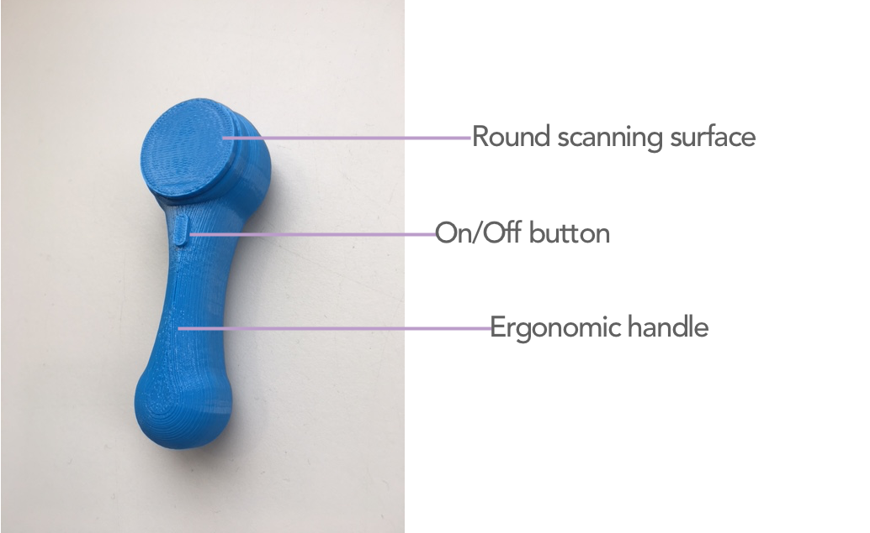
Final Prototype - Skin Sensor
Notes:
Include a URL to your clickable online prototype that demonstrates the key interactions.

Slide 21
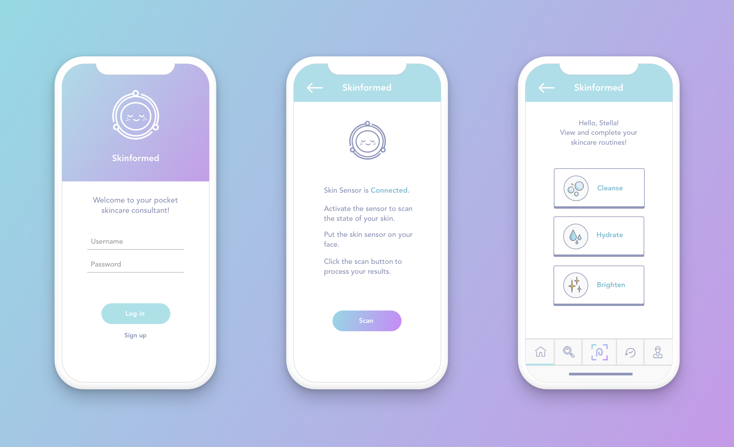
Final Prototype - Mobile Application
View Prototype
Notes:
Include a URL to your clickable online prototype that demonstrates the key interactions.

Slide 22
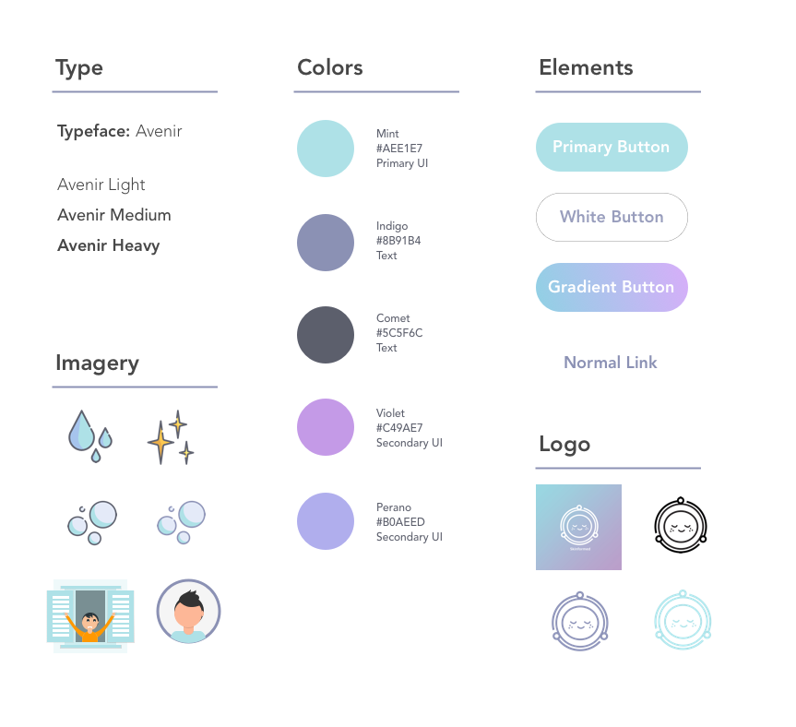
Design
Specifications
We aimed to maintain a very cohesive and uniform style guide in terms of colors and elements used throughout the mobile application.
We ensured that the colors used in imagery and buttons all aligned with the chosen color scheme.
Notes:
Design Specs:
Fonts
Sizes
Colors
Rules

Slide 23
Conclusion
Moving forward, both prototypes can be improved through many more user tests and iterations. Skinformed’s skin sensor can be iterated upon to optimize ergonomics and durability and improve aesthetic appeal. The Skinformed application can introduce new functions such as allowing users to mark and purchase products on the application to allow ease from purchase to usage or implementing a messenger system to allow users to chat with experts or other users on which products work best for which skin condition. Ideally, Skinformed can be marketed in the expanding skincare market and be utilized in place of expensive dermatologist visits for beginning skincare users.
Notes:
A conclusion slide with contact information and acknowledgements.

Slide 24
Process Materials
https://goo.gl/Qagdir
Notes:
Extra slides for any additional materials that demonstrate your process and were not included in the presentation slides (e.g., notes, photos, storyboards, etc.).
*Optionally, these materials can be in a subfolder in your team folder called “Process Materials”

Slide 25

Thanks!
Notes:
Extra slides for any additional materials that demonstrate your process and were not included in the presentation slides (e.g., notes, photos, storyboards, etc.).
*Optionally, these materials can be in a subfolder in your team folder called “Process Materials”

